Slide 1

Microservices Architecture Essentials
Key Concepts Around The Pattern
SoftUni Team
Technical Trainers
Software University
https://softuni.bg

Slide 2
Table of Contents
Why Microservices
Microservices Architecture
Data in Microservices
Logical vs Physical Architecture
Distributed Data Challenges
Microservices With .NET

Slide 3
Questions
sli.do #microservices

Slide 4

Why?

Slide 5
Why?
There are a lot of options for server architectures:
Simple CRUD, single-tier, single-layer
Traditional N-Layered
Domain-Driven Design N-layered
Clean Architecture
Command and Query Responsibility Segregation (CQRS)
Event-Driven Architecture (EDA)
Others…

Slide 6
Why?
And there are the Microservices!
A huge hype and everybody wants to do them!
Are they really necessary? Are they overly complex?
From my experience – hell no and hell yeah!
Microservices should be thoughtfully considered and researched!

Slide 7
Why?
Microservices:
Allow distributed applications
Allow independent development
Allow independent testing
Allow independent deployment
Allow independent versioning
These are the best characteristics of a microservice-based architecture
However, there are many drawbacks, especially if we are not careful

Slide 8
Why?
Microservices offer great benefits but also raise huge new challenges. Microservice architecture patterns are fundamental pillars when creating a microservice-based application.

Slide 9
Why?
A lot of companies realize cost efficiency
Introducing containers (not only to microservices) solves
Production problems
Deployment problems
Improves DevOps
Whatever the choice of stacks and technologies!
Docker is becoming the standard for containers
In the future Docker may be part of every data center
Just like the current state of virtual machines

Slide 10
The Microservices Decision Tree
Are you Netflix?
Are you Amazon?
Do you have a worldwide scale and customers?
Do you expect a huge increase in your customer base soon?
Do you have a struggling with performance monolith?
Do you have the recourses to develop microservices?

Slide 11
The Microservices Decision Tree
If any of this is "Yes", then do them!
It is always better to start with a monolith
And then extract microservices!
Also – make sure every team member is on the same page!

Slide 12
Microservices Architecture

Slide 13
Let's Start With Monoliths
Externally, a monolith is an application which
Is deployed as a single process
A single web application, solving all business requirements
A single process
You may use a container to simplify deployment
Internally, a monolith application is separated
Different layers – web layer, domain layer, service layer, etc.
You scale these by replicating them
And adding a load balancer in front of them

Slide 14
Let's Start With Monoliths
Benefits:
Simple development
Simple testing
Deployment is easy – single VM or container
Scaling is also easy

Slide 15
Let's Start With Monoliths
Drawbacks:
Huge applications have huge complexity
Slow startup time when the application grows
Each update redeploys everything
Continuous deployment is difficult
Bug in any module – brings down the whole application
Expensive to update dependencies

Slide 16
And Move to Microservices!
Microservice-based application:
Has many applications with different domains, working together
Usually for the back-end, but it is also used for the front-end
Each service runs its own process and communicate to others
Communication is done through HTTP(S), Web Sockets or Advanced Messaging
Each microservice has a context boundary and it is developed autonomously
Each microservice has its own isolated data layer
Size is not important. Internal cohesion and independence are!

Slide 17
And Move to Microservices!
Benefits:
The complexity is decomposed
Different teams work on different services
Deployment may be independent
Each service can be scaled independently

Slide 18
And Move to Microservices!
Drawbacks:
Complexity because of the distribution
Database needs eventual consistency and developers must be more careful
Developers need to handle partial failures
Debugging and deployment are more complex
Changes that span multiple services are more difficult to implement
Network starts to be a "thing"

Slide 19
And Move to Microservices!
How to build successful microservices
Monitoring and health checks
Scalable infrastructure – cloud and orchestrators
Security design at multiple levels – communication, authentication, authorization
Rapid application delivery – usually with different teams
DevOps and CI/CD practices
Microservices are challenging and should require careful thinking!
Do not use them as a golden hammer or because of a hype!

Slide 20
Data In Microservices

Slide 21
Data in Microservices
Important rules of microservices:
They should own their logic
They should own their data
The conceptual model may differ and that’s OK
Each microservice has its own Bounded Context
Logically grouped responsibilities

Slide 22
Data in Microservices
In traditional applications we have:
One or multiple databases (or equal)
It looks simpler initially, but the application ends up with huge tables which serve different subsystems
The ACID transactions are a huge advantage of the monoliths
Atomicity, Consistency, Isolation, Durability

Slide 23
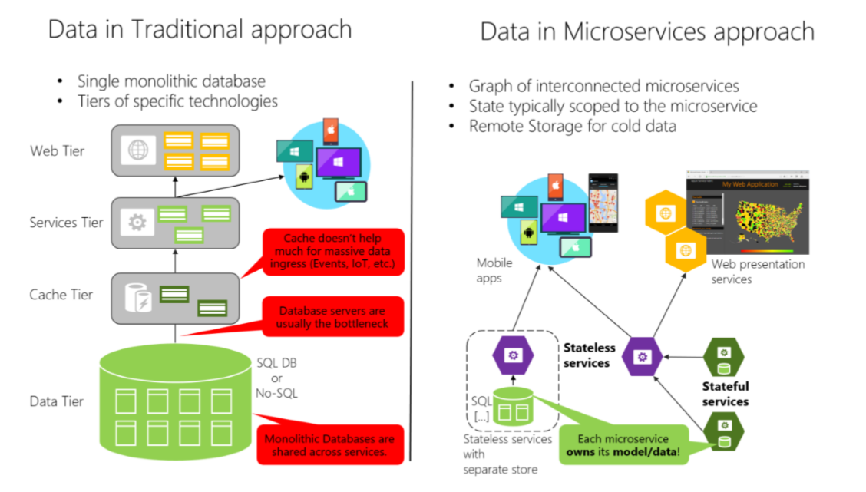
Data in Microservices

Slide 24
Data in Microservices
Data in microservices is very different
Much more complicated
Data owned by a microservice should be private to that microservice
The only way other microservices can access it are through its
API - REST, gRPC, etc.
Messaging – AMQP

Slide 25
Data in Microservices
Encapsulating data allows you to have loosely coupled microservices
Which can evolve independently
Consider data schema migrations
With distributed data structures, you cannot do a single ACID transaction
You need to use eventual consistency
When a business process spans multiple microservices

Slide 26
Data in Microservices
It is much harder than a normal SQL JOIN
There are no constraints
Most relational database features cannot be fully utilized
This does not mean you must use NoSQL database
It means data management is more complex
Different microservices can use different databases

Slide 27
Logical vs Physical Architecture

Slide 28
Logical vs Physical Architecture
There is a distinction between the logical and the physical architecture
The logical boundaries of the application do not need to map one-to-one to the physical deployment architecture
If you identity your Bounded Contexts, it does not mean that it is best to implement each one as a microservice
Some Bounded Contexts may need multiple physical servers
If your Bounded Context is independently versioned, deployed, and scaled

Slide 29
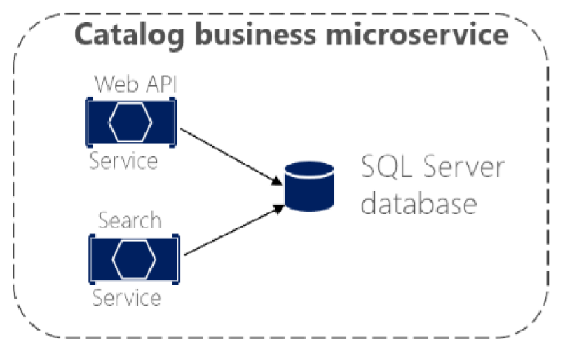
Logical vs Physical Architecture
Most commonly you will have one microservice per Bounded Context but that should not be a strict rule
Consider the following catalog microservice
You may decide to split the internal servers, so that you can scale them better

Slide 30
Distributed Data Challenges

Slide 31
How to Define Boundaries
Each microservice should be autonomous, yet part of the whole system
First try to identity "islands" of data and different business contexts
Then try to define the entities in each business context
Some entities may be the same with different names
For example – a user can be user, buyer, and customer at the same time
The main goal is to minimize the coupling between the contexts

Slide 32
Query That Span Multiple Services
Often, you will need to retrieve data from multiple microservices
While avoiding too much "chitty-chat" between them
Examples:
User information from the Identity, Catalog and Shopping Cart services
Complex report involving many tables across the system

Slide 33
Query That Span Multiple Services
You do not have a simple solution and it depends on the query
API Gateway
CQRS with query/read tables
"Cold Data" in central databases

Slide 34
Query That Span Multiple Services
API Gateway – separate microservice for aggregation purposes
It is the preferred way
But be careful with this one
It may lead to a chokepoint
You can create multiple fine-grained gateways for different "verticals" of the business

Slide 35
Query That Span Multiple Services
CQRS with query/read tables – generate in advance the data in a read-only table
Improves performance, but needs additional work and eventual consistency
You should use event-driven communication to update the tables
Cold Data” in central databases – extract separate databases
For complex reports with no real-time data
Event-driven communication or database import/export tools

Slide 36
Query That Span Multiple Services
Constantly need data from multiple services?
That may be a bad design
Consider merging microservices into a single entity
Do not create nanoservices!

Slide 37
Consistency Between Services
The challenge is to implement end-to-end business processes while keeping consistency across microservices
An example:
Catalog microservice – maintains information about products (including price)
Shopping Cart microservice – maintains current chosen products and price
When a product price is updated – you need to update the cart too (and show a message)

Slide 38
Consistency Between Services
In monolithic application this should be fairly easy
But with microservices – no service should include tables/storage from another one
And it should never call direct queries to them
Solution is event-based communication
Publish-Subscribe pattern

Slide 39
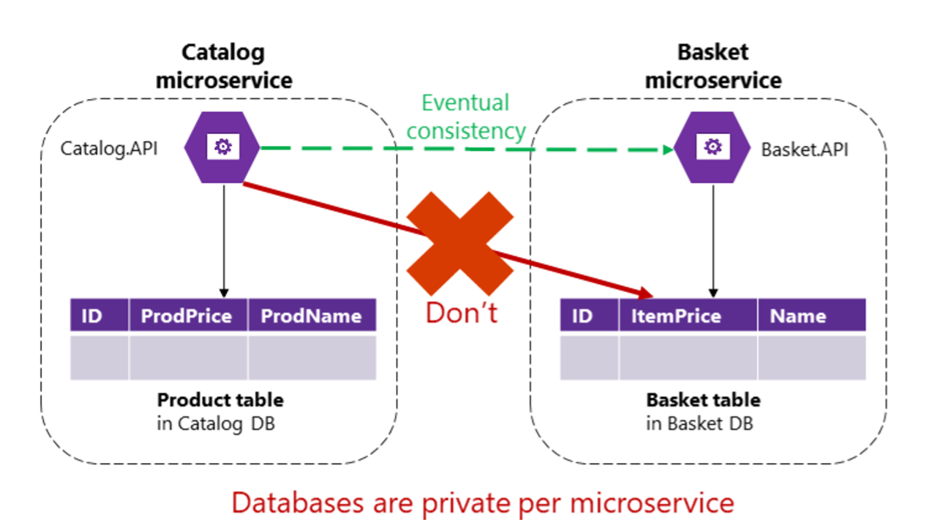
Consistency Between Services

Slide 40
Communication Between Services
The challenge about communication is not so much about the protocols
But more about the style and couplings
Because when failure occurs - the more coupled the system, the bigger issues you will have
Partial failures will happen, so you need to design the system considering the common risks

Slide 41
Communication Between Services
For example – popular approach is HTTP, because it is simple
HTTP is perfectly acceptable, but it depends on how you use it
Acceptable HTTP requests are:
Client-Microservice
Client-API Gateway
API Gateway-Microservice
Unacceptable HTTP requests are:
Microservice-Microservice

Slide 42
Communication Between Services
Consider the following scenario:
The client call the Orders microservice
Then the Orders microservice calls additional microservices for more information
Sounds reasonable at first

Slide 43
Communication Between Services
But these are the pitfalls:
Blocking and low performance – scalability is impacted
HTTP coupling on a business level – this should not occur
Failure will be difficult to manage – and failures occur
This way – we achieve a monolithic application across many processes
Solution is event-driven asynchronous communication

Slide 44
Microservices With .NET

Slide 45
Microservices With .NET
Choose .NET Core if you:
Develop and deploying cross-platform
You start a new project
Want to create a scalable system

Slide 46
Microservices With .NET
Choose .NET Framework if you:
Migrating an existing application
Using third-party NuGet libraries not ported for .NET Core
Use technologies not available on .NET Core
ASP.NET Web Forms
WCF Services

Slide 47

Summary
…
…
…
Why Microservices
Microservices Architecture
Data in Microservices
Logical vs Physical Architecture
Distributed Data Challenges
Microservices With .NET

Slide 48
Questions?
Notes:
48

Slide 49
Trainings @ Software University (SoftUni)
Software University – High-Quality Education, Profession and Job for Software Developers
softuni.bg, softuni.org
Software University Foundation
softuni.foundation
Software University @ Facebook
facebook.com/SoftwareUniversity
Software University Forums
forum.softuni.bg
Notes:
49

Slide 50

License
This course (slides, examples, demos, exercises, homework, documents, videos and other assets) is copyrighted content
Unauthorized copy, reproduction or use is illegal
© SoftUni – https://softuni.org
© Software University – https://softuni.bg
Notes:
50

